Slide 1
Sequences and Summations
Rafiullah Khan

Slide 2
Sequences
Sequences are ordered lists of elements, used in discrete mathematics in many ways.
The terms of a sequence can be specified by providing a formula for each term of the sequence.
Example
1, 2, 3, 5, 8 (Finite Sequence)
1, 2, 3, 5, 8 …………. (Finite Sequence)

Slide 3
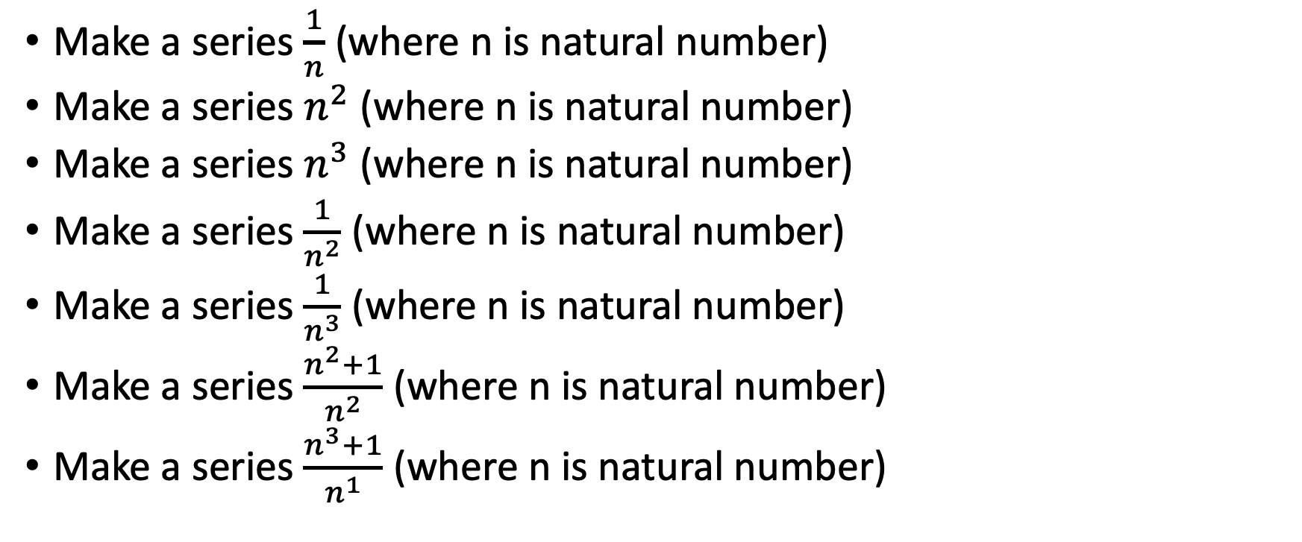
Sequence
Make a series $\frac{1}{n}$ (where n is natural number)
Make a series $n^{2}$ (where n is natural number)
Make a series $n^{3}$ (where n is natural number)
Make a series $\frac{1}{n^{2}}$ (where n is natural number)
Make a series $\frac{1}{n^{3}}$ (where n is natural number)
Make a series $\frac{n^{2}+1}{n^{2}}$ (where n is natural number)
Make a series $\frac{n^{3}+1}{n^{1}}$ (where n is natural number)

Slide 4
Sequence
1, -1, 1, -1, 1, -1 …………
6, 2, 2/3, 2/9, 2/27 ………..
2, 10, 50, 250, 1250 ……….
3, 12, 27, 48, 75 ……….
-1, 3, 7, 11, 15 …………

Slide 5
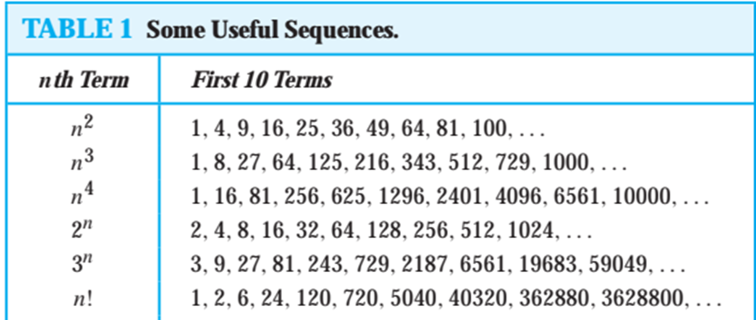
Useful Sequences

Slide 6

Summations
Next, we consider the addition of the terms of a sequence. For this we introduce summation notation. We begin by describing the notation used to express the sum of the terms am, am+1, . . . , an from the sequence {an}.
We can write it like

Slide 7
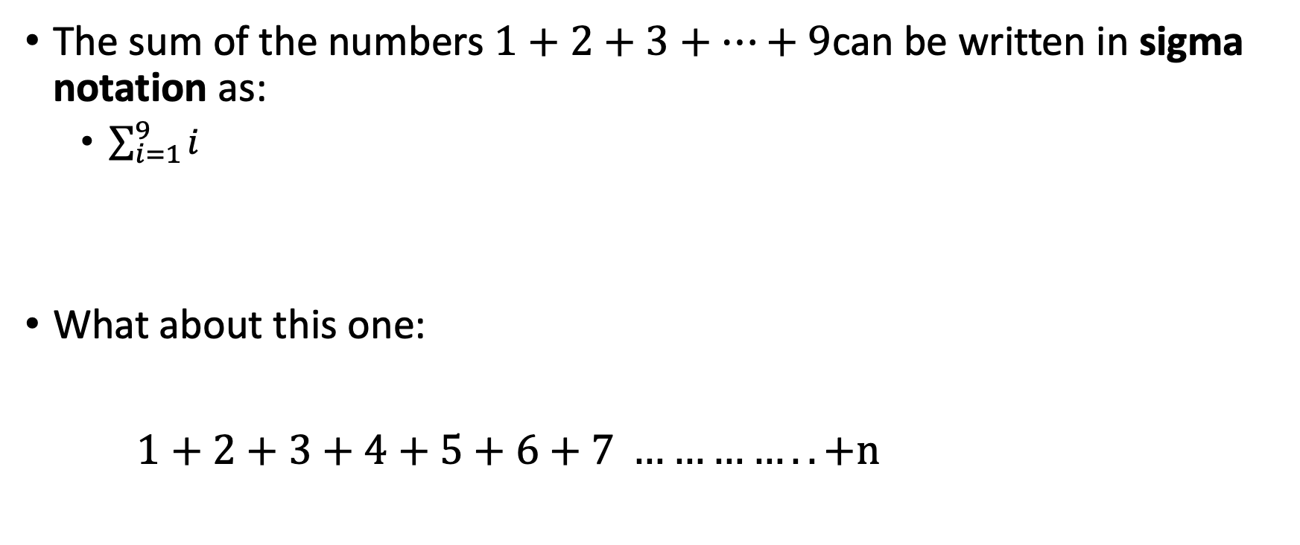
The sum of the numbers $1+2+3+⋯+9$can be written in sigma notation as:
$\sum_{i=1}^{9}{i}$
What about this one:
$1+2+3+4+5+6+7 ………….. +n$

Slide 8
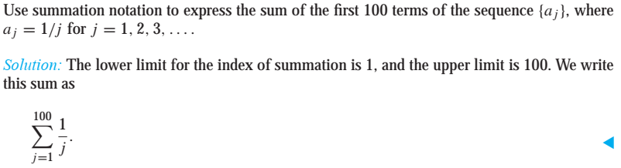
Summations (Example)

Slide 9

Questions
Solve the following Summations
$\sum_{i=1}^{15}{i}$
$\sum_{i=1}^{5}{i^{2}}$

Slide 10
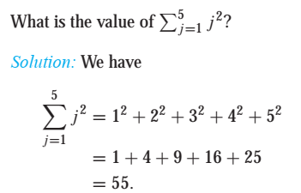
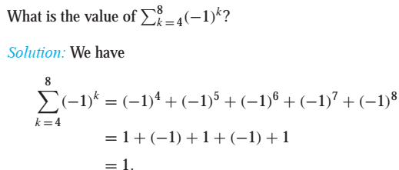
Summations (Example)

Slide 11
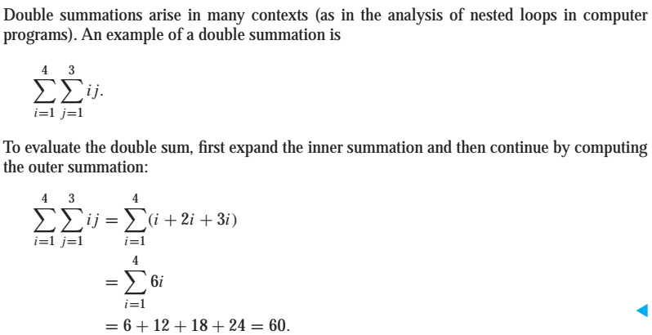
Double Summations (Example)

Slide 12
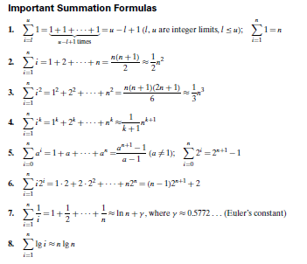

Slide 13

Summations
1+2+3+4+5+6+7+…………….200
1+4+9+25+…………………$n^{2}$

Slide 14
Assignment
Chapter 2.4, Page 167
Questions:
1, 2, 3, 4, 7, 8, 25, 26, 29, 30, 31, 32, 33, 34.
and
Solve the following Rabbit problem
Suppose a newly-born pair of rabbits, one male, one female, are put in a field. Rabbits are able to mate at the age of one month so that at the end of its second month a female can produce another pair of rabbits. Suppose that our rabbits never die and that the female always produces one new pair (one male, one female) every month from the second month on.

